Slide 1
Computer Algorithms Design and Analysis
UNIT-I
Recurrence Relations
Dr. N. Subhash Chandra,
Professor, CVRCE
Source: 1. Computer Algorithms by Horowitz, Sahani & Rajasekaran.
2. Algorithm by Coreman

Slide 2
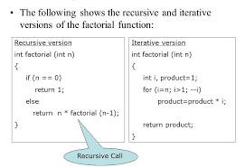
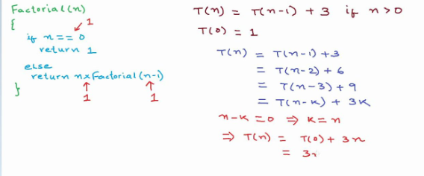
Need of Recurrence Relations

Slide 3
Recurrence relations
When an algorithm contains a recursive call to itself, its running time can obtain be described by a recurrence.
A recurrence is an equation or inequality that describes a function in terms of its value on smaller inputs.
This can be achieved by using any one of the three methods.
These methods are:
Iterative Method:
Substitution Method: Here we guess a bound and then use mathematical induction to prove our guess is correct.
Recursion Tree Method: In this method, we convert the recurrence into a tree whose nodes represent the costs incurred at various levels of the recursion.
Master Theorem: This method provides bounds for recurrences of the form
T(n) = a T(n/b) – f(n)
where a ≥ 1, b > 1 and f(n) is a given function

Slide 4
Recurrence Equations
A recurrence equation defines a function, say T(n).
The function is defined recursively, that is, the function T(n) appear in its definition.
For example:
T(n) = T(n-1)+T(n-2), if n>1
    1, if n=1 or n=0.
base case
for convenient, we sometime write the recurrence equation as:
T(n) = T(n-1)+T(n-2)
T(0) = T(1) = 1.

Slide 5
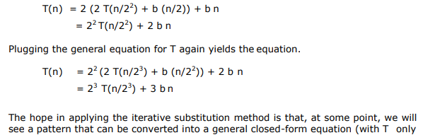
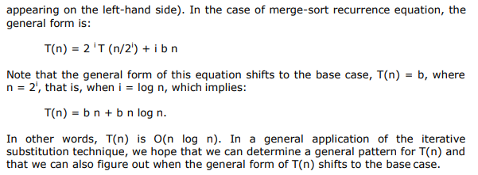
Iterative Method

Slide 6
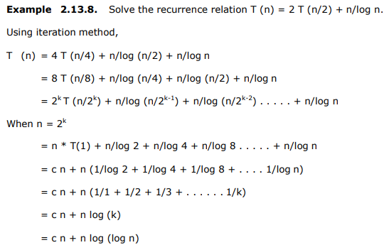
Iterative Method: Example

Slide 7
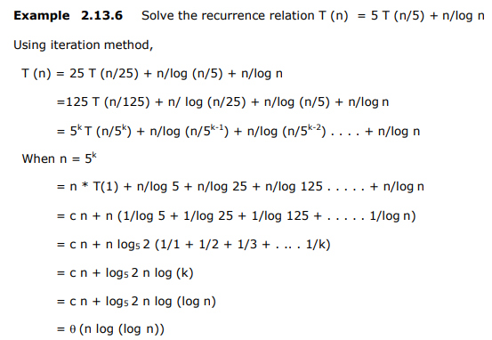
Iterative Method: Example

Slide 8
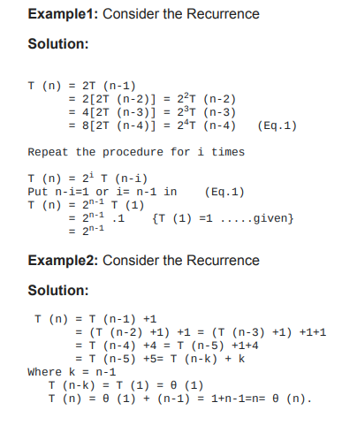
Iterative Method: Example

Slide 9
Substitution method
Step 1: Guess a solution
  T(n) = O(g(n))
  Induction goal: apply the definition of the asymptotic notation
    T(n) ≤ d g(n), for some d > 0 and n ≥ n₀
  Induction hypothesis: T(k) ≤ d g(k) for all k < n
Step 2: Prove the induction goal
  Use the induction hypothesis to find some values of the constants d and n₀ for which the induction goal holds

Slide 10
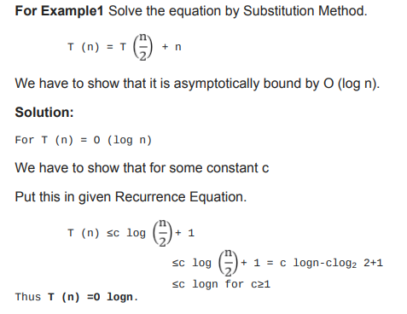
Substitution method

Slide 11
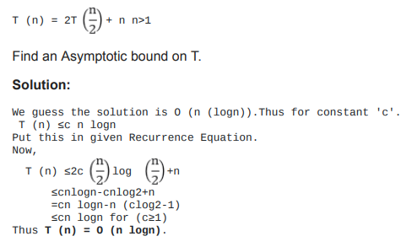
Substitution method

Slide 12
Example: Binary Search
T(n) = c + T(n/2)
Guess: T(n) = O(lgn)
  Induction goal: T(n) ≤ d lgn, for some d and n ≥ n₀
  Induction hypothesis: T(n/2) ≤ d lg(n/2)
Proof of induction goal:
T(n) = T(n/2) + c ≤ d lg(n/2) + c
= d lgn – d + c ≤ d lgn
if: – d + c ≤ 0, d ≥ c

Slide 13
Example 2
T(n) = T(n-1) + n
Guess: T(n) = O(n²)
  Induction goal: T(n) ≤ c n², for some c and n ≥ n₀
  Induction hypothesis: T(k-1) ≤ c(k-1)² for all k < n
Proof of induction goal:
T(n) = T(n-1) + n ≤ c (n-1)² + n
= cn² – (2cn – c - n) ≤ cn²
if: 2cn – c – n ≥ 0 ⇔ c ≥ n/(2n-1) ⇔ c ≥ 1/(2 – 1/n)
  For n ≥ 1 ⇒ 2 – 1/n ≥ 1 ⇒ any c ≥ 1 will work

Slide 14
Example 3
T(n) = 2T(n/2) + n
Guess: T(n) = O(nlgn)
  Induction goal: T(n) ≤ cn lgn, for some c and n ≥ n₀
  Induction hypothesis: T(n/2) ≤ cn/2 lg(n/2)
Proof of induction goal:
T(n) = 2T(n/2) + n ≤ 2c (n/2)lg(n/2) + n
= cn lgn – cn + n ≤ cn lgn
if: - cn + n ≤ 0 ⇒ c ≥ 1

Slide 15

Changing variables
T(n) = 2T( ) + lgn
  Rename: m = lgn ⇒ n = 2^{m}
  T (2^{m}) = 2T(2^{m/2}) + m
  Rename: S(m) = T(2^{m})
  S(m) = 2S(m/2) + m ⇒ S(m) = O(mlgm) (demonstrated before)
  T(n) = T(2^{m}) = S(m) = O(mlgm)=O(lgnlglgn)
  Idea: transform the recurrence to one that you have seen before

Slide 16
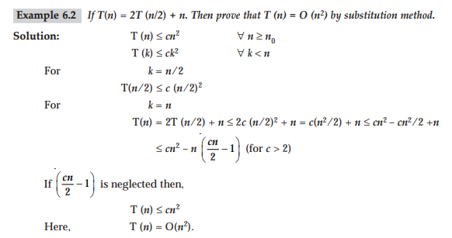
Example

Slide 17
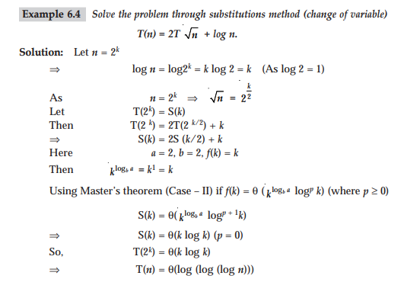
Example

Slide 18
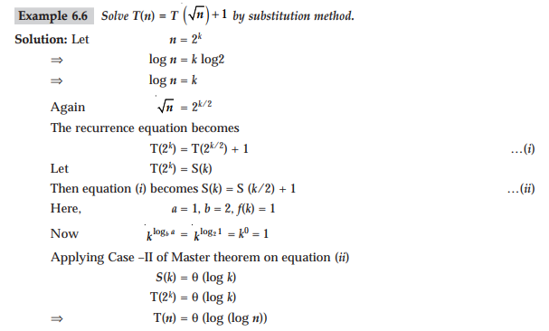
Example

Slide 19
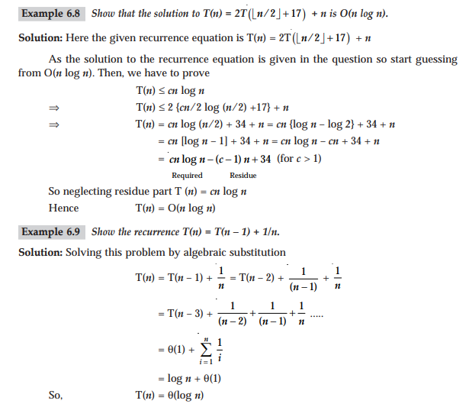
Example

Slide 20
Recursion Tree Method
Recursion tree method converts the recurrence into a tree whose nodes represent costs incurred at various levels of the recursion.
So the basic idea is:
→ Each node represents the cost of a single subproblem.
→ Sum up the costs with each level to get level cost.
→ Sum of all the level costs to get total cost.
Recursion tree method is particularly suitable for divide and conquer recurrence. It is best used to generate a good guess, tolerating "sloppiness"

Slide 21
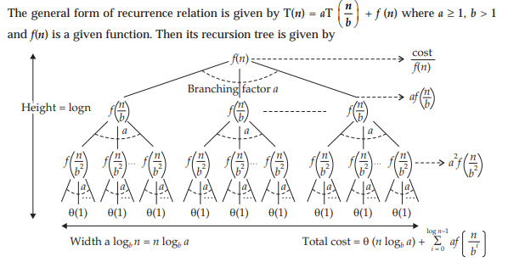
Recursion Tree Method

Slide 22
Recursion Tree-
A recursion tree is a tree where each node represents the cost of a certain recursive sub-problem.
We sum up the values in each node to get the cost of the entire algorithm.
Steps to Solve Recurrence Relations Using Recursion Tree Method-
Step-01:
Draw a recursion tree based on the given recurrence relation.
Step-02:
Determine-
Cost of each level
Total number of levels in the recursion tree Number of nodes in the last level
Cost of the last level
Step-03:
Add cost of all the levels of the recursion tree and simplify the expression so obtained in terms of asymptotic notation.
Following problems clearly illustrates how to apply these steps.
PRACTICE PROBLEMS BASED ON RECURSION TREE-
Problem-01:
Solve the following recurrence relation using recursion tree method- T(n) = 2T(n/2) + n
Solution-

Slide 23
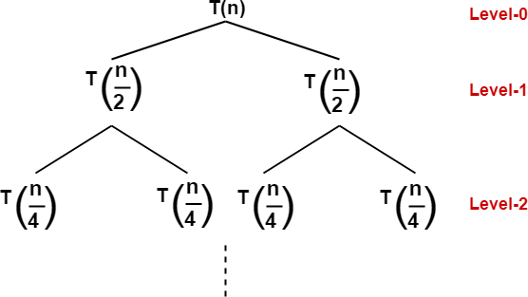
Step-01:
Draw a recursion tree based on the given recurrence relation. The given recurrence relation shows-
A problem of size n will get divided into 2 sub-problems of size n/2.
Then, each sub-problem of size n/2 will get divided into 2 sub-problems of size n/4 and so on.
At the bottom most layer, the size of sub-problems will reduce to 1.
This is illustrated through following recursion tree-
The given recurrence relation shows-
The cost of dividing a problem of size n into its 2 sub-problems and then combining its solution is n.
The cost of dividing a problem of size n/2 into its 2 sub-problems and then combining its solution is n/2 and so on.
This is illustrated through following recursion tree where each node represents the cost of the corresponding sub-problem-

Slide 24
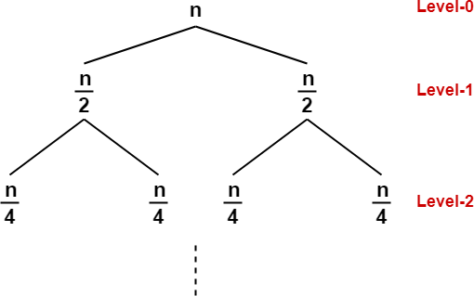
Step-02:
Determine cost of each level- Cost of level-0 = n
Cost of level-1 = n/2 + n/2 = n
Cost of level-2 = n/4 + n/4 + n/4 + n/4 = n and so on.
Step-03:
Determine total number of levels in the recursion tree- Size of sub-problem at level-0 = n/2⁰
Size of sub-problem at level-1 = n/2¹
Size of sub-problem at level-2 = n/2²
Continuing in similar manner, we have- Size of sub-problem at level-i = n/2^{i}
Suppose at level-x (last level), size of sub-problem becomes 1. Then- n / 2^{x} = 1
2^{x} = n
Taking log on both sides, we get- xlog2 = logn
x = log₂n
∴ Total number of levels in the recursion tree = log₂n + 1

Slide 25

Step-04:
Determine number of nodes in the last level- Level-0 has 2⁰ nodes i.e. 1 node
Level-1 has 2¹ nodes i.e. 2 nodes
Level-2 has 2² nodes i.e. 4 nodes
Continuing in similar manner, we have- Level-log₂n has 2^{log2n} nodes i.e. n nodes
Step-05:
Determine cost of last level-
Cost of last level = n x T(1) = θ(n)
Step-06:
Add costs of all the levels of the recursion tree and simplify the expression so obtained in terms of asymptotic notation-
= n x log₂n + θ (n)
= nlog₂n + θ (n)
= θ (nlog₂n)
Problem-02:
Solve the following recurrence relation using recursion tree method- T(n) = T(n/5) + T(4n/5) + n
Solution-
Step-01:
Draw a recursion tree based on the given recurrence relation. The given recurrence relation shows-
A problem of size n will get divided into 2 sub-problems- one of size n/5 and another of size 4n/5.

Slide 26
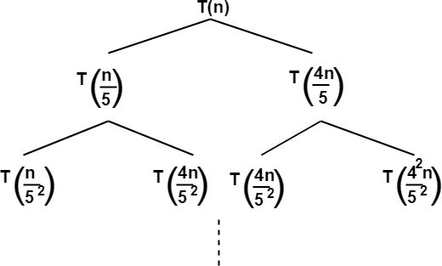
Then, sub-problem of size n/5 will get divided into 2 sub-problems- one of size n/5² and another of size 4n/5².
On the other side, sub-problem of size 4n/5 will get divided into 2 sub-problems- one of size 4n/5² and another of size 4²n/5² and so on.
At the bottom most layer, the size of sub-problems will reduce to 1.
This is illustrated through following recursion tree-
The given recurrence relation shows-
The cost of dividing a problem of size n into its 2 sub-problems and then combining its solution is n.
The cost of dividing a problem of size n/5 into its 2 sub-problems and then combining its solution is n/5.
The cost of dividing a problem of size 4n/5 into its 2 sub-problems and then combining its solution is 4n/5 and so on.
This is illustrated through following recursion tree where each node represents the cost of the corresponding sub-problem-

Slide 27
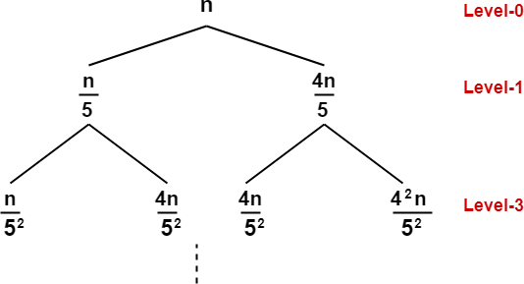
Step-02:
Determine cost of each level- Cost of level-0 = n
Cost of level-1 = n/5 + 4n/5 = n
Cost of level-2 = n/5² + 4n/5² + 4n/5² + 4²n/5² = n
Step-03:
Determine total number of levels in the recursion tree. We will consider the rightmost sub tree as it goes down to the deepest level-
Size of sub-problem at level-0 = (4/5)⁰n Size of sub-problem at level-1 =(4/5)¹n Size of sub-problem at level-2 =(4/5)²n
Continuing in similar manner, we have- Size of sub-problem at level-i = (4/5)^{i}n
Suppose at level-x (last level), size of sub-problem becomes 1. Then- (4/5)^{x}n = 1
(4/5)^{x} = 1/n
Taking log on both sides, we get- xlog(4/5) = log(1/n)
x = log_{5/4}n
∴ Total number of levels in the recursion tree = log_{5/4}n + 1

Slide 28

Step-04:
Determine number of nodes in the last level- Level-0 has 2⁰ nodes i.e. 1 node
Level-1 has 2¹ nodes i.e. 2 nodes
Level-2 has 2² nodes i.e. 4 nodes
Continuing in similar manner, we have- Level-log_{5/4}n has 2^{log5/4n} nodes
Step-05:
Determine cost of last level-
Cost of last level = 2^{log5/4n} x T(1) = θ(2^{log5/4n}) = θ(n^{log5/42})
Step-06:
Add costs of all the levels of the recursion tree and simplify the expression so obtained in terms of asymptotic notation-
= nlog_{5/4}n + θ(n^{log5/42})
= θ(nlog_{5/4}n)
Problem-03:
Solve the following recurrence relation using recursion tree method- T(n) = 3T(n/4) + cn²
Solution-
Step-01:
Draw a recursion tree based on the given recurrence relation-

Slide 29
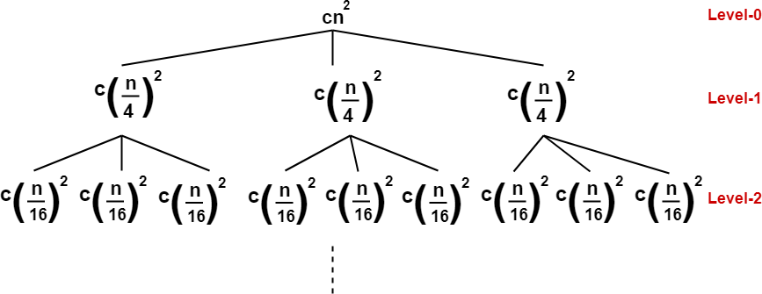
(Here, we have directly drawn a recursion tree representing the cost of sub problems)
Step-02:
Determine cost of each
level- Cost of level-0 = cn²
Cost of level-1 = c(n/4)² + c(n/4)² + c(n/4)² = (3/16)cn²
Cost of level-2 = c(n/16)² x 9 = (9/16²)cn²
Step-03:
Determine total number of levels in the recursion tree- Size of sub-problem at level-0 = n/4⁰
Size of sub-problem at level-1 = n/4¹
Size of sub-problem at level-2 = n/4²
Continuing in similar manner, we have- Size of sub-problem at level-i = n/4^{i}
Suppose at level-x (last level), size of sub-problem becomes 1. Then- n/4^{x} = 1
4^{x} = n
Taking log on both sides, we get- xlog4 = logn
x = log₄n
∴ Total number of levels in the recursion tree = log₄n + 1
Step-04:

Slide 30
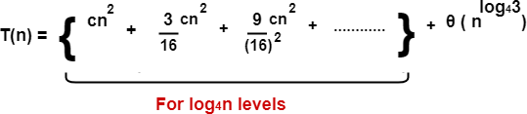
Determine number of nodes in the last level-
Level-0 has 3⁰ nodes i.e. 1 node Level-1 has 3¹ nodes i.e. 3 nodes Level-2 has 3² nodes i.e. 9 nodes
Continuing in similar manner, we have- Level-log₄n has 3^{log4n} nodes i.e. n^{log43} nodes
Step-05:
Determine cost of last level-
Cost of last level = n^{log43} x T(1) = θ(n^{log43})
Step-06:
Add costs of all the levels of the recursion tree and simplify the expression so obtained in terms of asymptotic notation-
= cn² { 1 + (3/16) + (3/16)² + ……… } + θ(n^{log43})
Now, { 1 + (3/16) + (3/16)² + ……… } forms an infinite Geometric progression. On solving, we get-
= (16/13)cn² { 1 – (3/16)^{log4n} } + θ(n^{log43})
= (16/13)cn² – (16/13)cn² (3/16)^{log4n} + θ(n^{log43})
= O(n²)

Slide 31
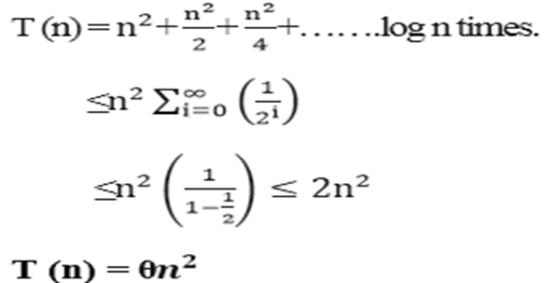
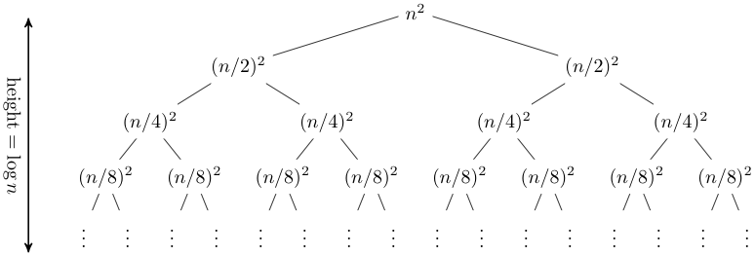
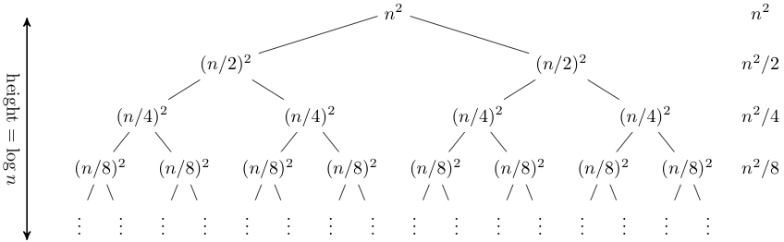
Example
T (n) = 2T (n/2) + n²

Slide 32
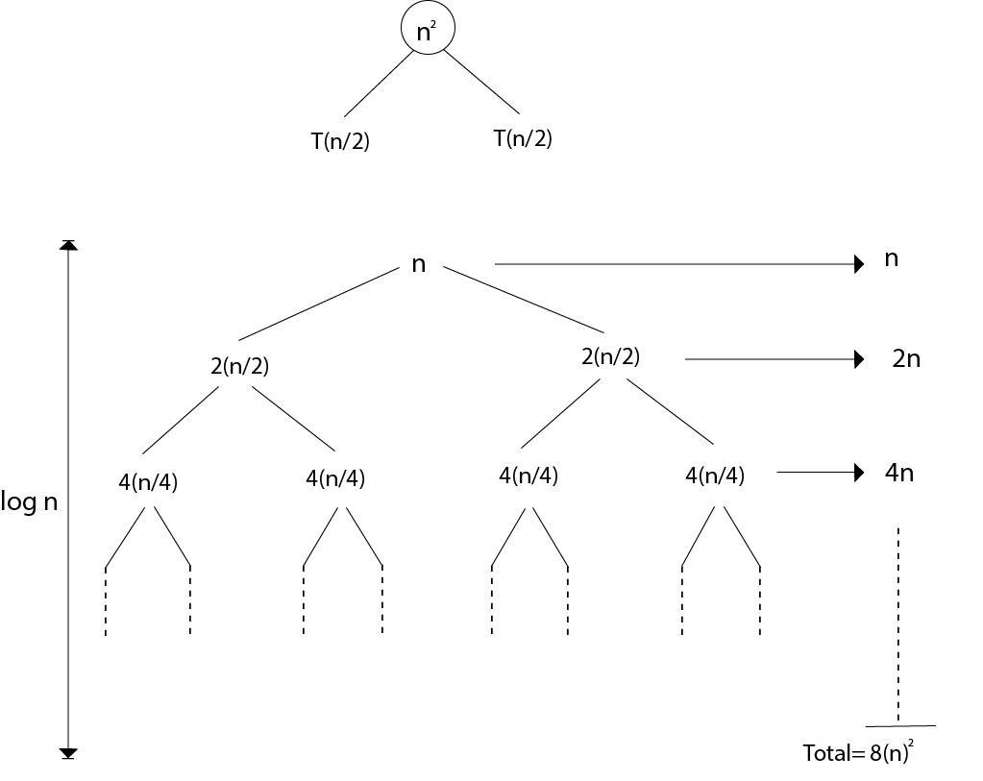
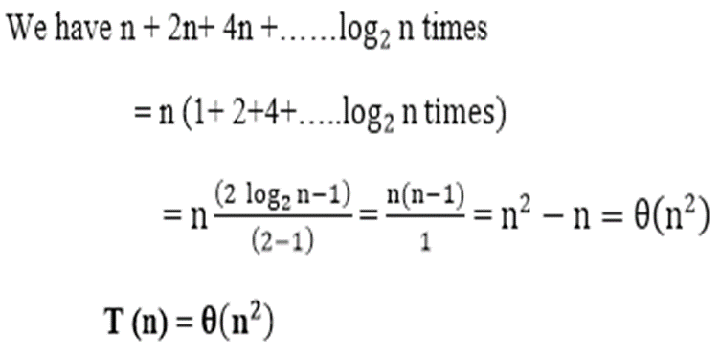
Example : T (n) = 4T (n/2)+n

Slide 33

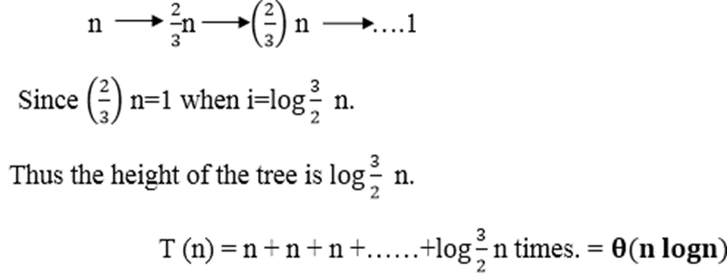
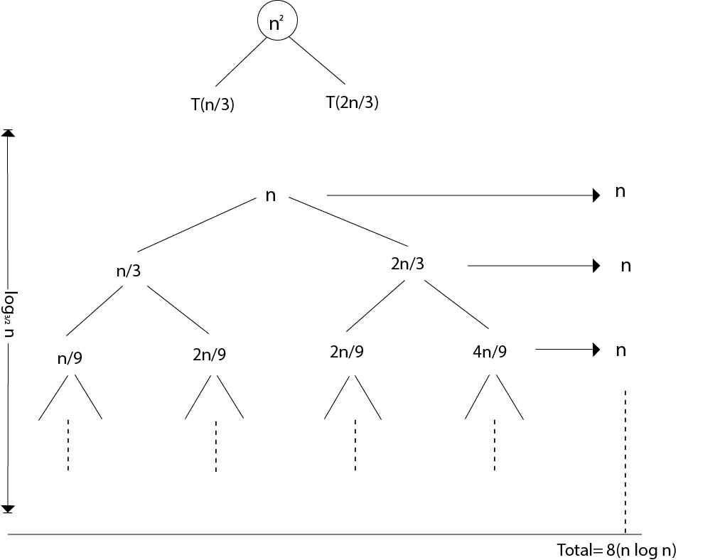
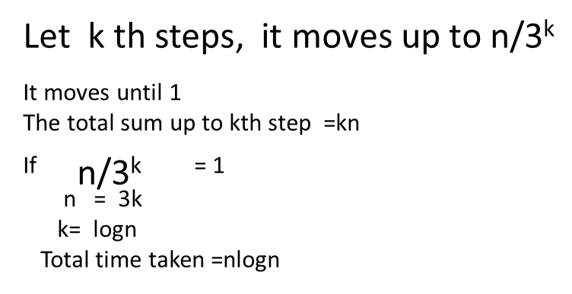

Slide 34
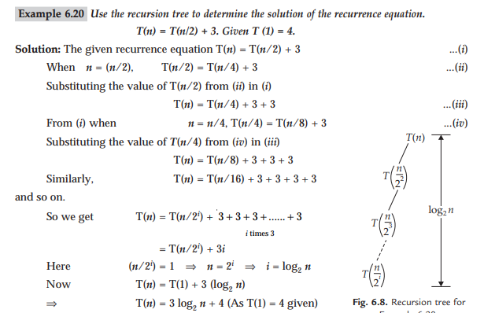

Slide 35
The Master Method
Based on the Master theorem.
“Cookbook” approach for solving recurrences of the form
  T(n) = aT(n/b) + f(n)
    a ≥ 1, b > 1 are constants.
    f(n) is asymptotically positive.
    n/b may not be an integer, but we ignore floors and ceilings.
Requires memorization of three cases.

Slide 36
The Master Theorem
Theorem 4.1
Let a ≥ 1 and b > 1 be constants, let f(n) be a function, and
Let T(n) be defined on nonnegative integers by the recurrence
T(n) = aT(n/b) + f(n), where we can replace n/b by ⎣n/b⎦ or ⎡n/b⎤.
T(n) can be bounded asymptotically in three cases:
If f(n) = O(n^{logba–ε}) for some constant ε > 0, then T(n) = Θ(n^{logba}).
If f(n) = Θ(n^{logba}), then T(n) = Θ(n^{logba}lg n).
If f(n) = Ω(n^{logba+ε}) for some constant ε > 0,
and if, for some constant c < 1 and all sufficiently large n,
we have a·f(n/b) ≤ c f(n), then T(n) = Θ(f(n)).

Slide 37
Master Method – Examples
T(n) = 16T(n/4)+n
  a = 16, b = 4, n^{logba} = n^{log416} = n².
  f(n) = n = O(n^{logba-ε}) = O(n^{2-ε} ), where ε = 1 ⇒ Case 1.
  Hence, T(n) = Θ(n^{logba} ) = Θ(n²).
T(n) = T(3n/7) + 1
  a = 1, b=7/3, and n^{logba} = n^{log 7/3 1} = n⁰ = 1
  f(n) = 1 = Θ(n^{logba}) ⇒ Case 2.
  Therefore, T(n) = Θ(n^{logba} lg n) = Θ(lg n)

Slide 38
Master Method – Examples
T(n) = 3T(n/4) + n lg n
  a = 3, b=4, thus n^{logba} = n^{log43} = O(n^{0.793})
  f(n) = n lg n = Ω(n^{log43 + ε} ) where ε ≈ 0.2 ⇒ Case 3.
  Therefore, T(n) = Θ(f(n)) = Θ(n lg n).
T(n) = 2T(n/2) + n lg n
  a = 2, b=2, f(n) = n lg n, and n^{logba} = n^{log22} = n
  f(n) is asymptotically larger than n^{logba}, but not polynomially larger. The ratio lg n is asymptotically less than n^{ε} for any positive ε. Thus, the Master Theorem doesn’t apply here.

Slide 39

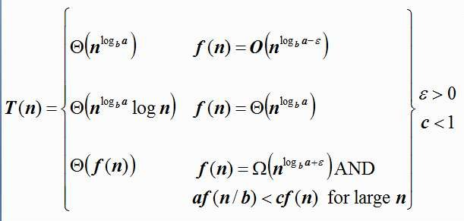
Master Method – Examples
T(n) = 9T(n/3) + n
  a=9, b=3, f(n) = n
  n^{logba} = n^{log39} = Θ(n²)
  Since f(n) = n, f(n)< n^{logb a}
  Case 1 applies:
T (n) = Θ(n^{logb a} )when f (n) = O(n^{logb a−ε} )
  Thus the solution is T(n) = Θ(n²)

Slide 40
Problems on The Master Method
T(n) = 4T(n/2) + n²
  a = 4, b = 2, f(n)=n²
  _{n}log_{b}a _{= n}2
  Since, f(n)=n²
  Thus, f(n)= n^{logba}
  Case 2 applies:
f (n) = Θ(n²logn)
  Thus the solution is T(n) = Θ(n²log n).

Slide 41
Master Method – Examples
Ex. T(n) = 4T(n/2) + n³ a = 4, b = 2, f(n)=n³ n^{logba} = n²; f (n) = n³.
Since, f(n)=n³ Thus, f(n)> n^{logba}




Case 3 applies:
f (n) = Ω(n³)
and 4(n/2)³ ≤ cn³ (regulatory condition) for c = 1/2.
T(n) = Θ(n³).

Slide 42
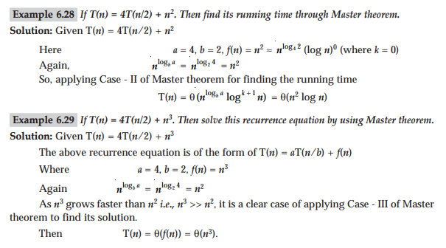
Example

Slide 43
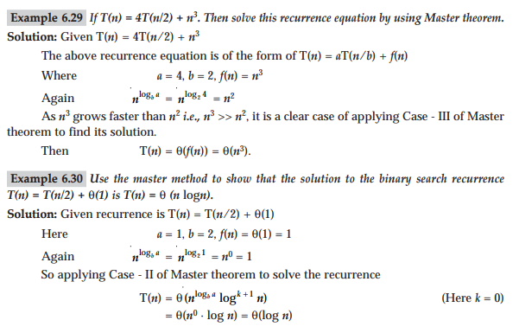
Example

Slide 44
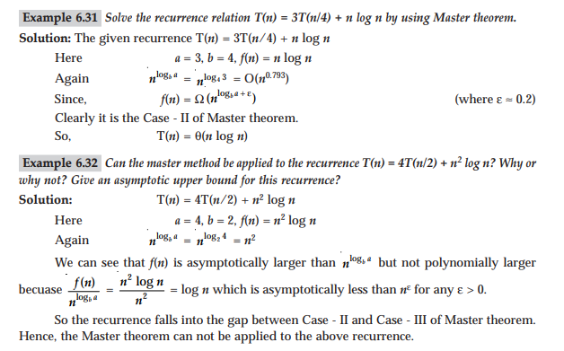
Example

Slide 45
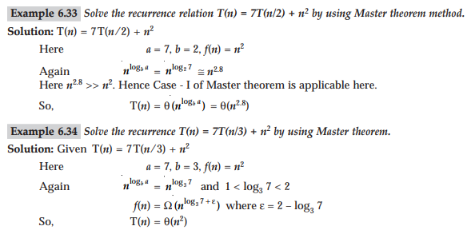
Example

Slide 46
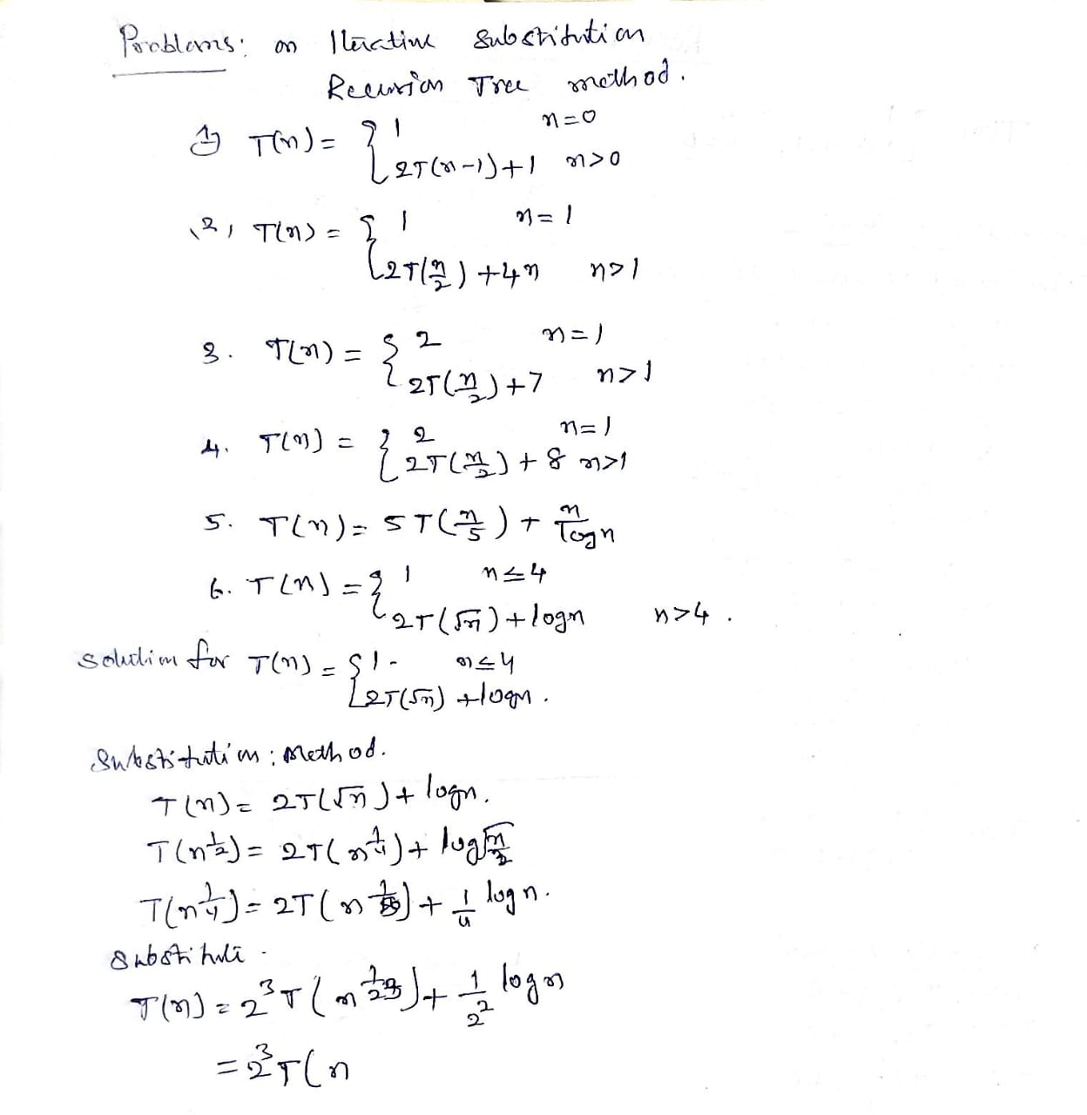
Examples

Slide 47
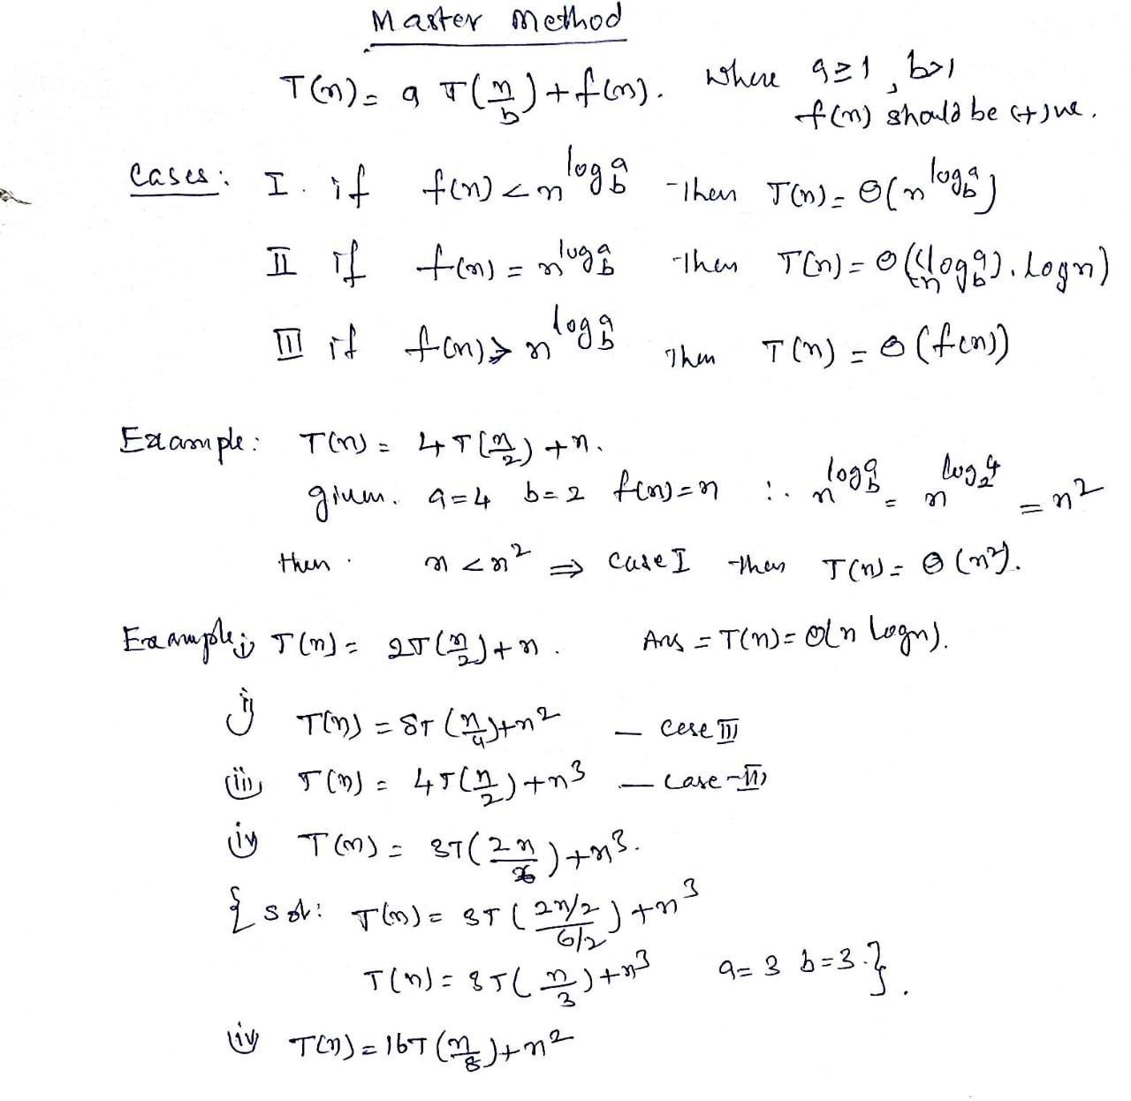
Master Method – Examples

Slide 48
Some Common Recurrence Relation
Recurrence Relation | Complexity | Problem
T(n) = T(n/2) + c | O(logn) | Binary Search
T(n) = 2T(n-1) + c | O(2^{n}) | Tower of Hanoi
T(n) = T(n-1) + c | O(n) | Linear Search
T(n) = 2T(n/2) + n | O(nlogn) | Merge Sort
T(n) = T(n-1) + n | O(n²) | Selection Sort, Insertion Sort
T(n) = T(n-1)+T(n-2) + c | O(2^{n}) | Fibonacci Series

